Slide 1
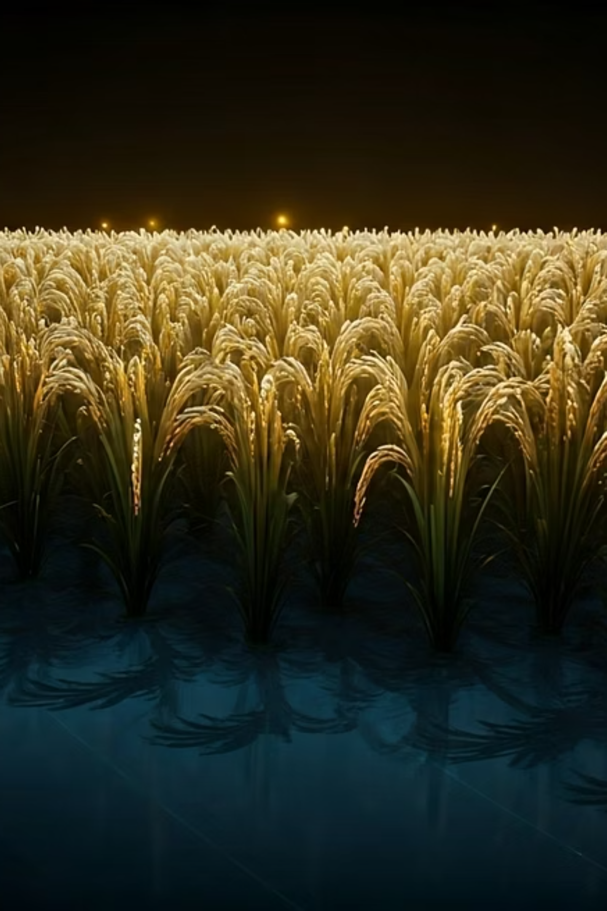
GrainPalette: A Deep Learning Odyssey in Rice Type Classification Through Transfer Learning
This presentation introduces GrainPalette, an AI-powered web application designed to revolutionize agricultural practices through accurate rice type classification using advanced deep learning techniques.
Presented by: Team ID: LTVIP2025TMID43062
Team Members:
T Naga Manikanta (Team Leader)
K Sai Ganesh
D Nandini
S Keerthi

Slide 2
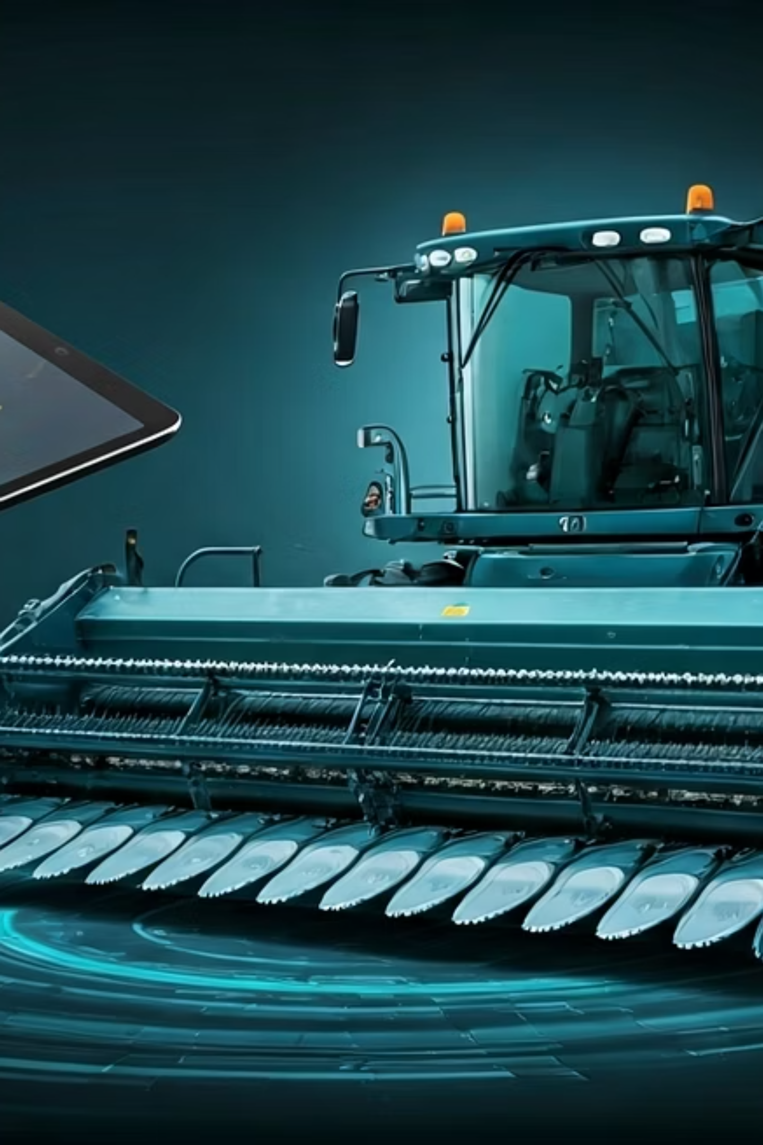
Introduction to GrainPalette
Web-Based Platform
GrainPalette is an intuitive web-based application designed for the precise classification of five distinct rice varieties.
Deep Learning Integration
Leveraging MobileNetV2 with transfer learning, our platform achieves high accuracy in identifying rice types.
Real-time Predictions
Users receive instant classification results directly through a user-friendly browser interface.
Agricultural Enhancement
This AI-driven solution aims to significantly enhance efficiency and decision-making in agricultural practices.

Slide 3

Addressing the Problem: Challenges in Rice Classification
Slow Manual Identification
High Misclassification Rates
Current manual methods for rice identification are time-consuming and prone to human error, leading to inefficiencies.
The International Rice Research Institute (IRRI, 2024) reports misclassification rates between 23% and 41%, impacting quality control.
Significant Economic Losses
Limited Tools for Small Farmers
Adulterated rice results in substantial financial losses, estimated at $2.1 billion annually, affecting farmers and consumers alike.
Small-scale farmers often lack access to advanced, affordable tools for accurate rice variety identification, hindering their productivity and market access.

Slide 4
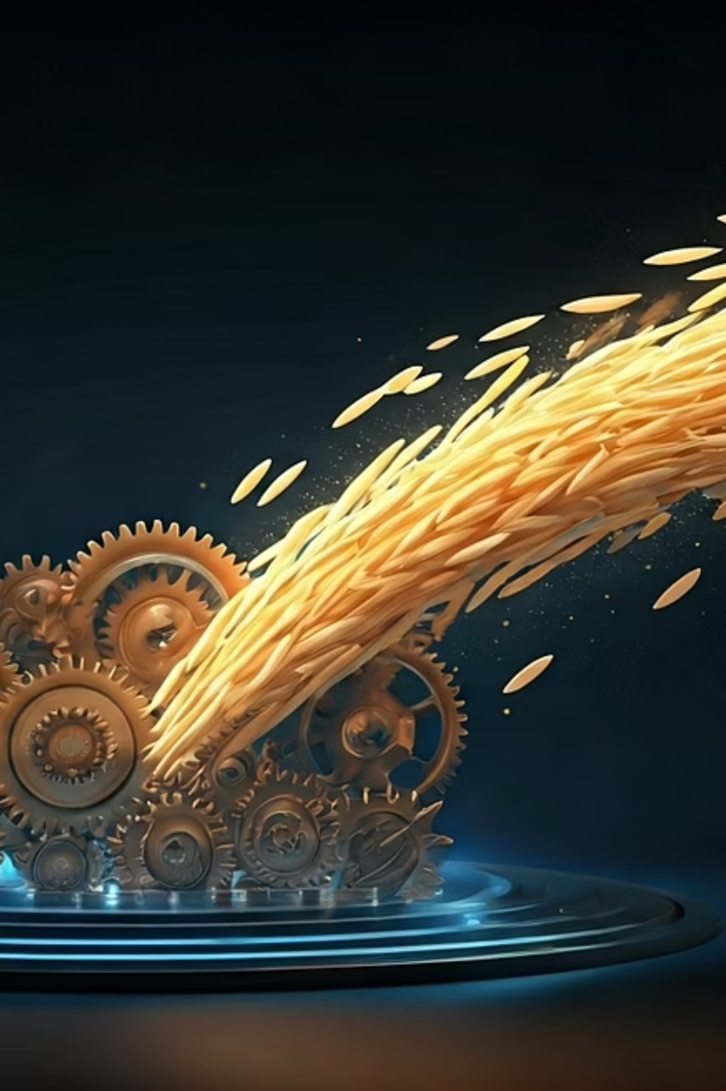




GrainPalette's Objectives: Precision, Accessibility, and Transparency
Scalable Classification Tool
Our primary goal is to build a robust and scalable tool capable of accurately classifying various rice types.
Improved Accuracy
By leveraging transfer learning, we aim to significantly enhance classification accuracy compared to traditional methods.
Instant & Transparent Predictions
GrainPalette provides real-time, easily understandable predictions to empower users with immediate insights.
Global Accessibility
We are committed to ensuring the tool is accessible across diverse regions and various devices, reaching a broad user base.

Slide 5

Meet the Team Behind GrainPalette
K Daniel Joseph
Kavyasri Koduri
Role: Team Leader, Model Integration, Cloud Deployment
Role: UI/UX Design, Preprocessing Pipeline
Kavyasri crafted the intuitive user interface and experience, and built the critical image preprocessing pipeline.
Daniel spearheaded the integration of the deep learning model into the application and managed its deployment on cloud infrastructure.
Yamparala Priyanka
K Anusha
Role: Dataset Collection, Performance Testing
Role: Flask Backend, API Development
Priyanka meticulously collected and curated the rice image dataset, and rigorously tested the model's performance to ensure accuracy.
Anusha was responsible for developing the robust Flask backend and designing the RESTful APIs that connect the frontend to the AI model.

Slide 6





GrainPalette System Architecture
Web Upload
Users easily upload rice images through a secure web interface.
Preprocessing
Images undergo essential preprocessing (OpenCV) for optimal model input.
Flask App
The Flask application serves as the core, managing user requests and model interactions.
RiceClassifier
The deep learning model (MobileNetV2) performs the actual rice type classification.
Results Page
Classification results, along with Grad-CAM visualizations, are displayed for fast feedback.

Slide 7
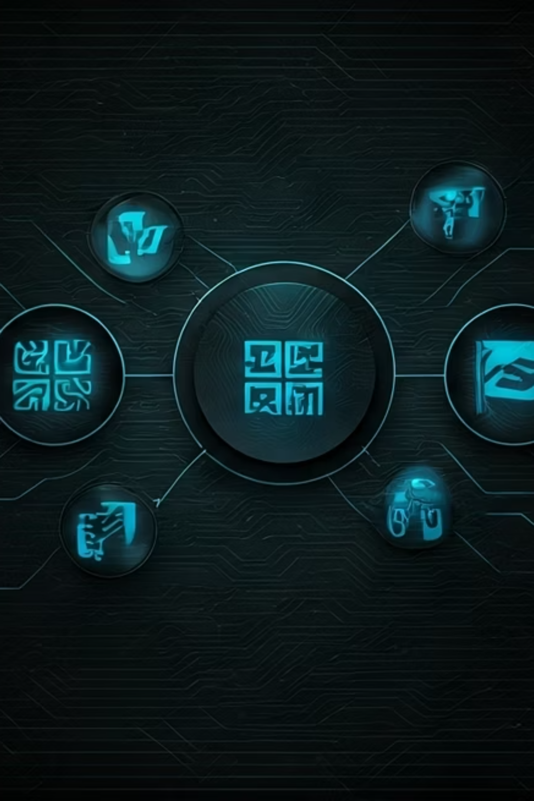
GrainPalette Technology Stack
Frontend
AI/ML
Deployment
HTML: Structure of web pages
TensorFlow: Open-source machine learning framework
Docker: Containerization for consistent environments
CSS: Styling and responsive design
MobileNetV2: Efficient deep learning model for mobile vision applications
AWS: Cloud services for scalable hosting
Backend
Python: Primary programming language
Security & Compliance
Image Processing
Flask: Lightweight web framework for API development
HTTPS: Secure communication
OpenCV: Computer vision library for image manipulation
JWT: Token-based authentication
GDPR: Data privacy compliance

Slide 8
Model Architecture: MobileNetV2 & Xception
Highlights
Our classification model is built upon the robust foundations of MobileNetV2 and Xception architectures, pre-trained on the vast ImageNet dataset. This transfer learning approach allows us to leverage pre-existing knowledge and significantly accelerate training while maintaining high performance.
We fine-tuned these models specifically on our diverse rice dataset, optimizing them for precise rice type identification. A key feature of our implementation is the use of Grad-CAM (Gradient-weighted Class Activation Mapping), which provides visual interpretability by highlighting the areas of the image that are most important for the model's decision, enhancing trust and understanding.
Through rigorous testing and fine-tuning, our model achieved impressive accuracy rates ranging from 97.5% to 99.8%, demonstrating its reliability and effectiveness in real-world scenarios.

Slide 9
GrainPalette Functional Workflow
User Uploads Image
The user initiates the process by securely uploading an image of rice through the intuitive web interface.
Image Preprocessing
The uploaded image undergoes automated preprocessing steps, including resizing and normalization, to prepare it for model input.
AI Model Prediction
The preprocessed image is fed into our deep learning model, which analyzes its features and predicts the specific rice variety.
Result & Grad-CAM Display
The predicted rice variety is displayed to the user along with a Grad-CAM visualization, highlighting the key features used for classification.
Report Availability
Users can then download or share a detailed report of the classification, enabling further analysis or record-keeping.

Slide 10
GrainPalette Functional Workflow
User Uploads Image
The user initiates the process by securely uploading an image of rice through the intuitive web interface.
Image Preprocessing
The uploaded image undergoes automated preprocessing steps, including resizing and normalization, to prepare it for model input.
AI Model Prediction
The preprocessed image is fed into our deep learning model, which analyzes its features and predicts the specific rice variety.
Result & Grad-CAM Display
The predicted rice variety is displayed to the user along with a Grad-CAM visualization, highlighting the key features used for classification.
Report Availability
Users can then download or share a detailed report of the classification, enabling further analysis or record-keeping.

Slide 11
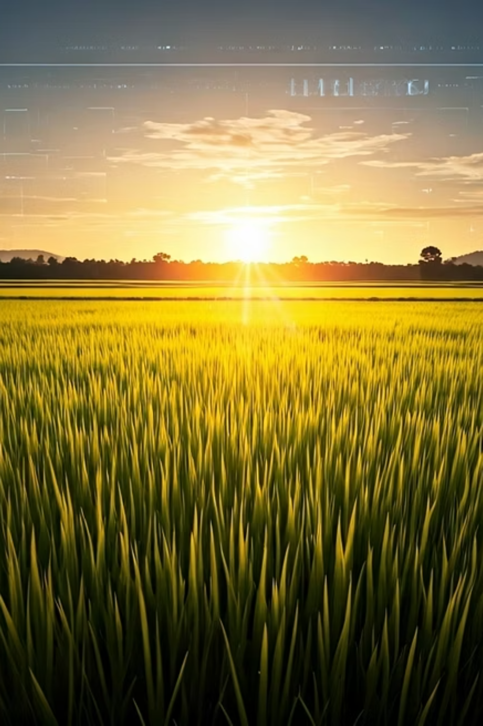
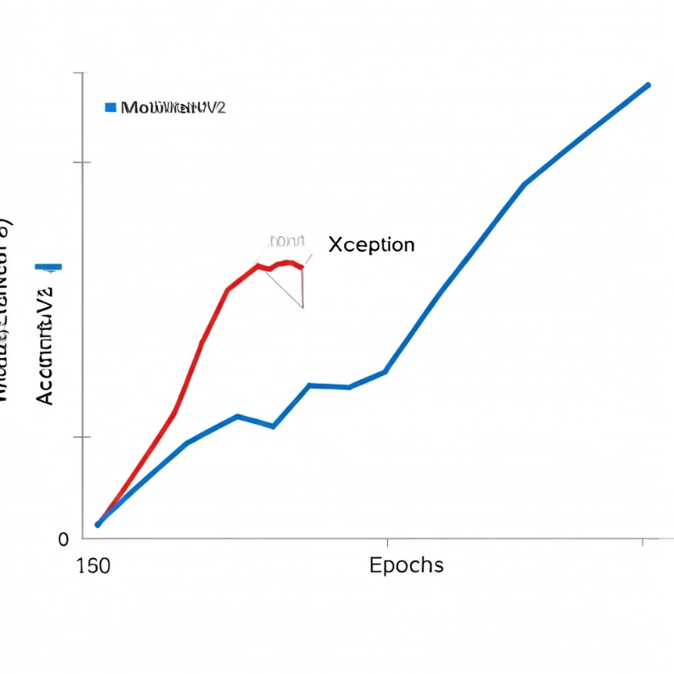
Advanced Model Training & Accuracy
Our GrainPalette system leverages state-of-the-art deep learning architectures for robust and accurate rice variety classification. We conducted extensive training to ensure optimal performance and generalization.
Training Summary:
Model Architectures: MobileNetV2 and Xception were chosen for their balance of efficiency and predictive power.
Training Epochs: Both models were rigorously trained for 20 epochs to achieve convergence.
MobileNetV2 Accuracy: Achieved approximately 97.5% classification accuracy on our validation dataset.
Xception Accuracy: Demonstrated superior performance with an impressive ~99.8% classification accuracy.
Overfitting Prevention: Extensive data augmentation techniques were employed to enhance model robustness and prevent overfitting, ensuring reliable performance on unseen data.

Slide 12
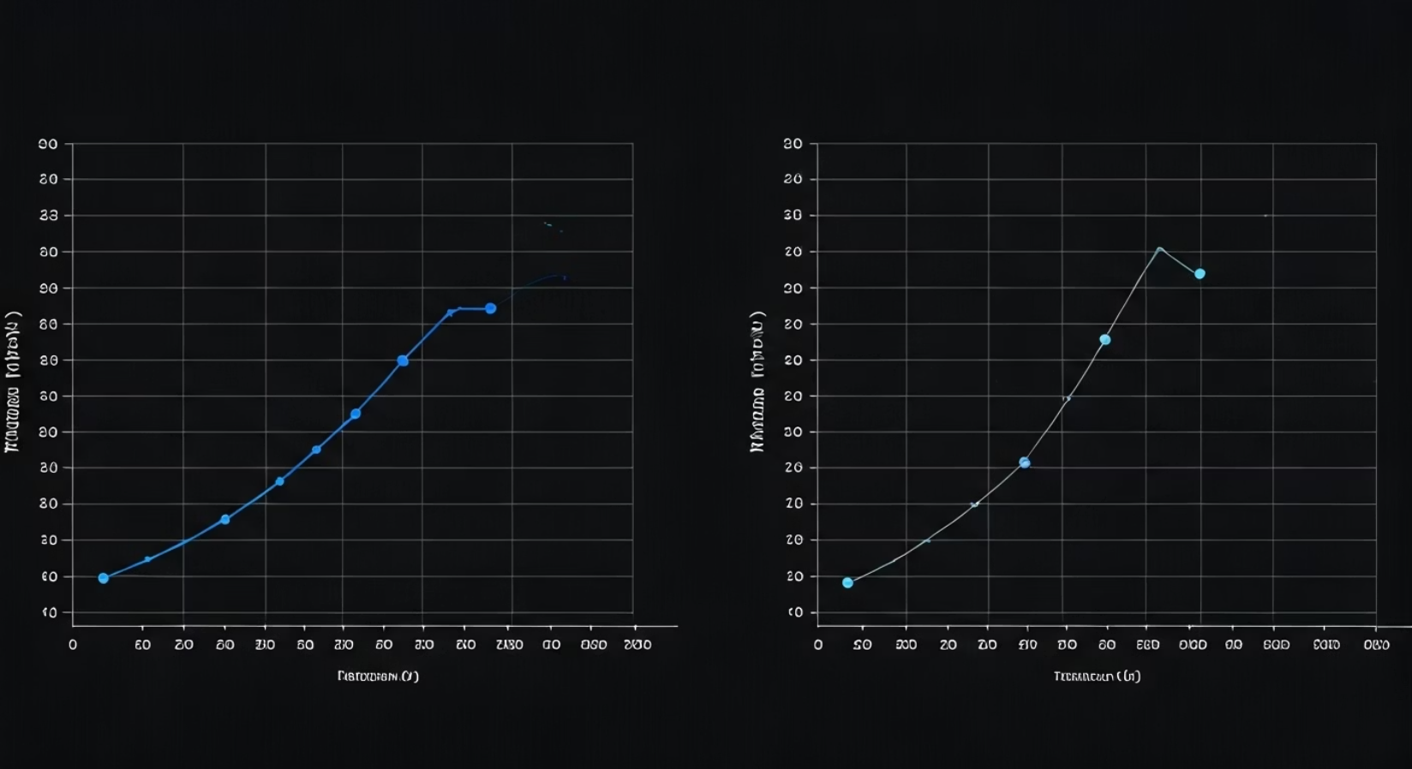
Advanced Model Training & Accuracy
GrainPalette's core relies on robust deep learning models. We extensively trained two state-of-the-art architectures, MobileNetV2 and Xception, for 20 epochs to achieve optimal performance.
MobileNetV2: Achieved approximately 97.5% accuracy.
Xception: Demonstrated superior performance with around 99.8% accuracy.
To prevent overfitting and ensure model generalization, we implemented extensive data augmentation techniques, including rotations, flips, zooms, and brightness adjustments.

Slide 13



Seamless Flask Web Application Integration
app.py: Core Flask Logic
REST API for Predictions
Dockerized for Scalability
The backend is powered by app.py, handling all primary Flask operations and routing requests. This central script orchestrates the interaction between the user interface and the AI classification model.
A robust REST API facilitates image uploads and real-time predictions. It ensures secure handling of data through JSON Web Tokens (JWT) for authentication and HTTPS for encrypted communication.
The entire application is containerized using Docker, ensuring portability, consistent environments, and effortless scalability across different deployment scenarios, from local machines to cloud servers.
The seamless integration between the Flask backend, the AI model, and the frontend UI creates a fluid and efficient classification workflow for users.

Slide 14
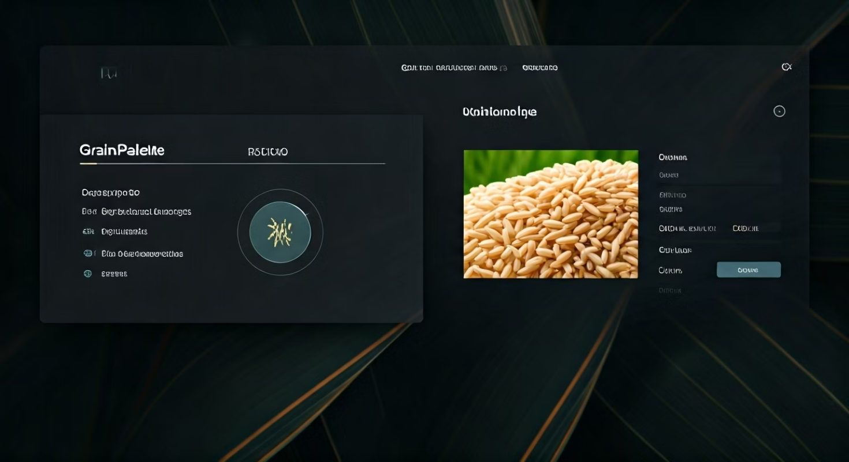
Intuitive User Interface Design
The user interface of GrainPalette is meticulously designed for a streamlined and intuitive experience, ensuring accessibility for all users, regardless of technical expertise.
Clean Drag-and-Drop Upload Form: Simplifies the process of submitting images for analysis, reducing friction and improving user engagement.
Mobile-Responsive Layout: Ensures optimal viewing and interaction across various devices, from desktops to smartphones, enhancing usability in diverse agricultural settings.
Real-time Image Validation: Provides immediate feedback on image quality and format, preventing errors and ensuring accurate predictions.
Displays Prediction, Confidence & Heatmap: Presents clear, actionable results, including the predicted rice variety, confidence score, and a visual heatmap (Grad-CAM) to highlight areas of importance in the image.

Slide 15
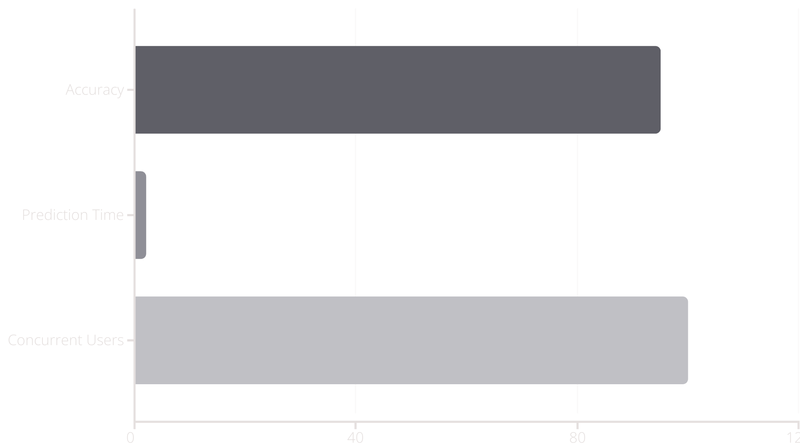
Rigorous Testing & Validation
Extensive testing was conducted to ensure the reliability and efficiency of GrainPalette. Our performance testing yielded impressive results, validating the system's readiness for real-world application.
Accuracy: Consistently achieved 95%+ classification accuracy in diverse test datasets.
Prediction Time: Maintained an average prediction time of less than 2 seconds per image, crucial for rapid decision-making in the field.
Load Tested: Successfully handled up to 100 concurrent users without performance degradation, demonstrating scalability.
Bug Fixes: Addressed and resolved critical issues related to input formats, Flask crashes, and latency, enhancing system stability and user experience.

Slide 16





Key Advantages of GrainPalette
High Accuracy
Instant Results
Explainability with Grad-CAM
Achieving near-perfect classification rates, GrainPalette provides reliable and precise identification of rice varieties, minimizing errors.
With prediction times under 2 seconds, critical decisions can be made rapidly, optimizing agricultural workflows and reducing delays.
Visual heatmaps highlight key features used for classification, building trust and providing insights into the AI's decision-making process.
Scalable Architecture
Intuitive Web UI
Designed for flexibility, the Dockerized Flask application can easily scale to meet growing demands, accommodating more users and data.
A user-friendly interface ensures ease of use for all, making advanced AI technology accessible to a broad audience of agricultural professionals.

Slide 17
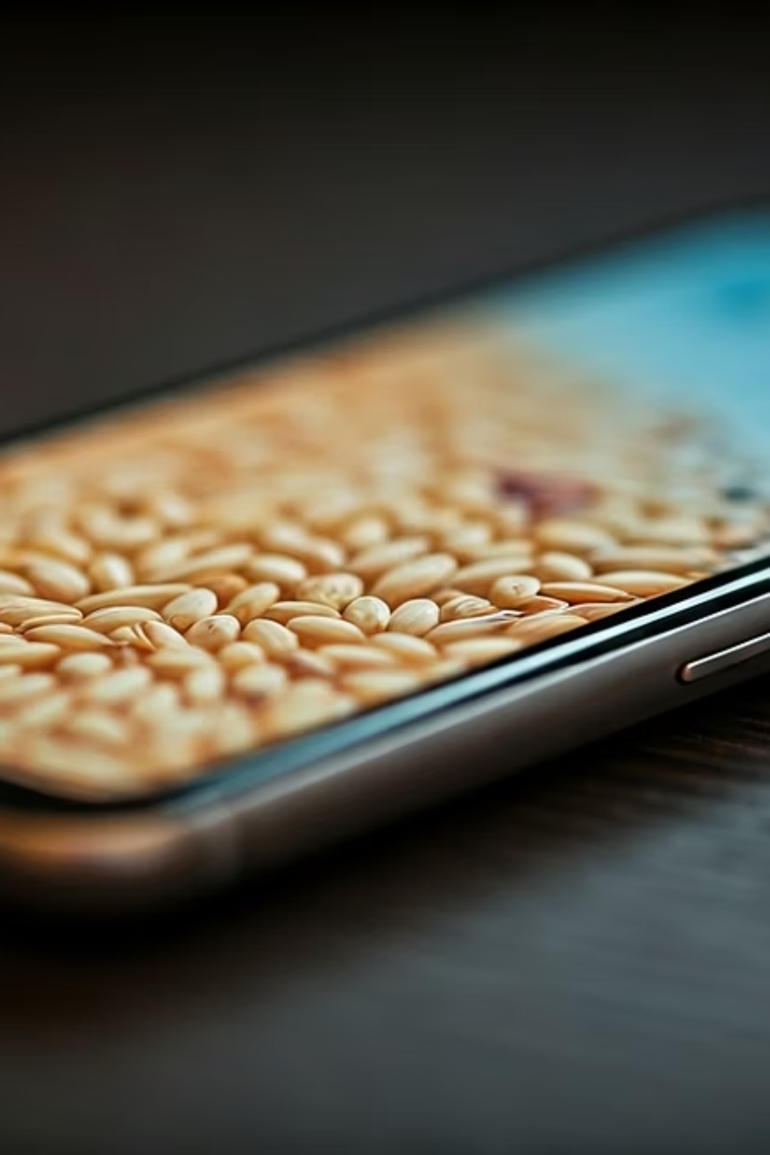
Current Limitations
Limited to 5 Rice Varieties
The current model is trained to classify five specific rice varieties. While highly accurate for these, it needs expansion to cover more types.
Requires High-Quality Input Images
Optimal performance depends on clear, well-lit images of rice grains, potentially limiting use in sub-optimal field conditions.
Demo Version: Local Deployment Only
The current iteration is primarily for local deployment, limiting broad accessibility without further cloud integration.
No Offline Support (Yet)
GrainPalette currently requires an internet connection for operation, which can be a constraint in remote agricultural areas.

Slide 18

Future Scope
Expanded Variety Recognition
Cloud Deployment & Accessibility
Future iterations aim to significantly increase the number of rice varieties the model can classify, enhancing its applicability globally.
Future plans include migrating to a cloud-based infrastructure to enable wider accessibility and seamless usage for agricultural professionals worldwide.
Enhanced Image Robustness
Offline Functionality Integration
Development will focus on making the model more resilient to varying image qualities, including low light or blurred conditions, for broader field utility.
We aim to implement offline support, allowing GrainPalette to operate in remote areas without internet access, ensuring continuous productivity.

Slide 19
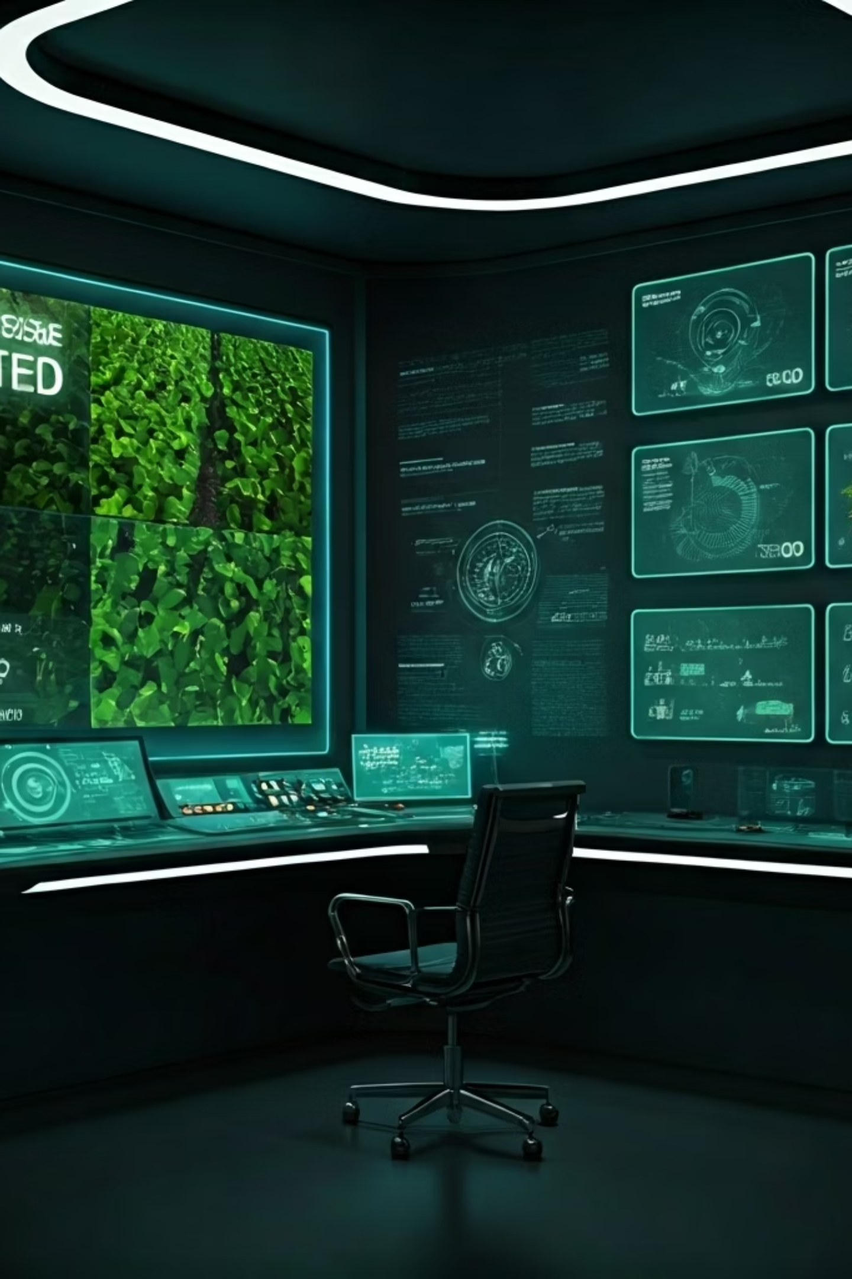



Strategic Initiatives & Future Innovations
Multilingual Platform
Crop Disease Detection
Develop a robust multilingual base, significantly improving usability and accessibility for non-English speaking agricultural professionals worldwide.
Integrate advanced image analysis capabilities to accurately detect common rice crop diseases, providing early warnings and actionable insights to farmers.
Blockchain & IoT Integration
Explore combining GrainPalette with blockchain for transparent supply chain traceability and IoT devices for real-time environmental data monitoring.

Slide 20
Conclusion: Bridging AI and Agriculture
GrainPalette bridges AI & agriculture
Solves real-world problems for farmers
Accurate, fast, and scalable
The system delivers highly accurate predictions with remarkable speed, all built upon a scalable architecture ready for future growth and wider adoption.
Our project demonstrates the powerful synergy between artificial intelligence and the agricultural sector, showcasing how technology can revolutionize traditional farming practices.
By offering accurate and rapid rice variety classification, GrainPalette directly addresses critical challenges faced by farmers, from quality control to yield optimization.
Foundation for smart farming tools
Trusted predictions with explainable AI
GrainPalette serves as a foundational component for developing more sophisticated smart farming tools, paving the way for data-driven agricultural practices.
Through explainable AI features like Grad-CAM, users can trust the predictions, understanding how the AI arrives at its conclusions.

Slide 21
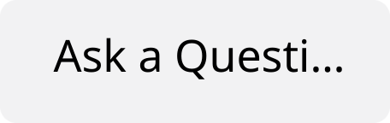

Thank You!
We appreciate your time and attention today. We are now open to any questions you may have and welcome your valuable feedback.

